Slide 1

A Presentation on “TAV-Cart: Transaction Assistance and Validation Cart System for Effortless Shopping and Checkout” By Tanish Singh Rajpal - B202 Akshit Naithani - B208 Vansh Mistry - B223 Under the Guidance of Prof. Kiran Salunke
Department of Computer Engineering
MPSTME, Shirpur Campus
2023-24

Slide 2



Slide 3

MUKESH PATEL SCHOOL OF TECHNOLOGY
MANAGEMENT & ENGINEERING
Shirpur Campus
MUKESH PATEL SCHOOL OF TECHNOLOGY MANAGEMENT & ENGINEERING, SHIRPUR CAMPUS

Slide 4



MUKESH PATEL SCHOOL OF TECHNOLOGY
MANAGEMENT & ENGINEERING
Shirpur Campus

Slide 5
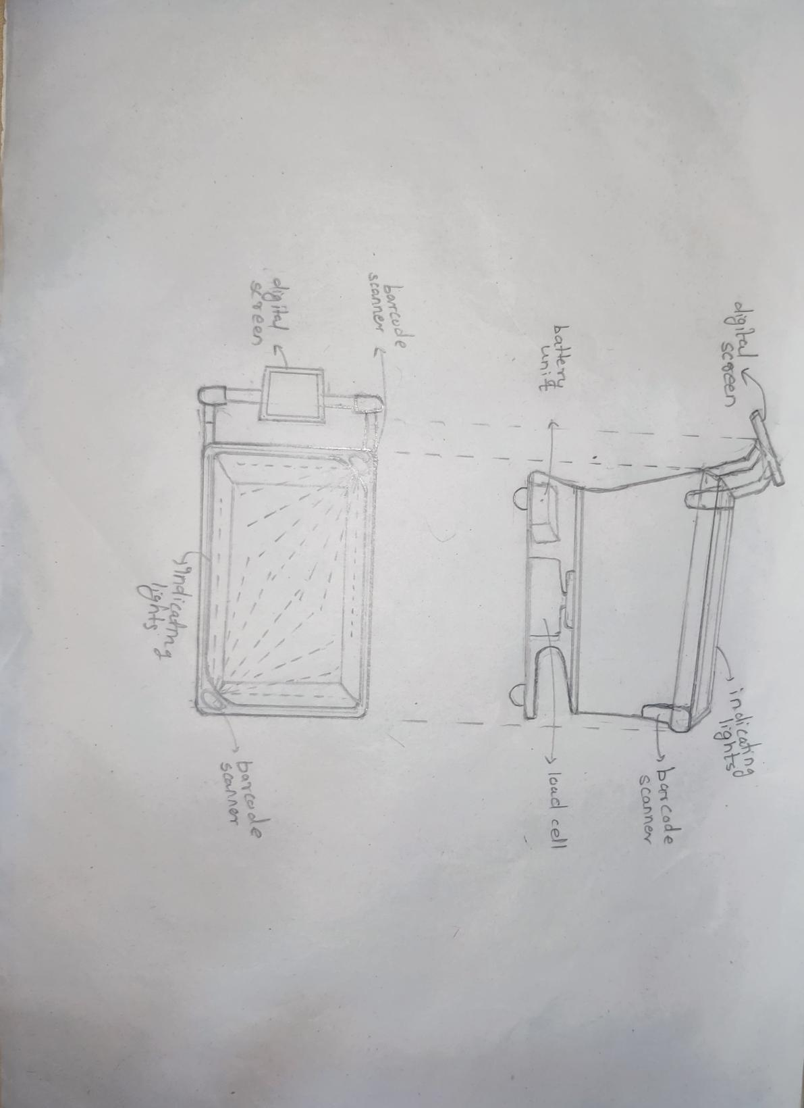
TAV Cart prototype sketch

Slide 6
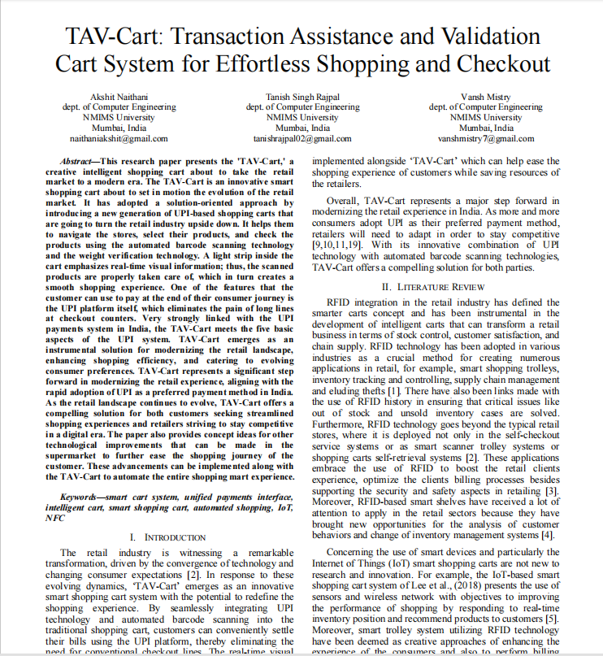
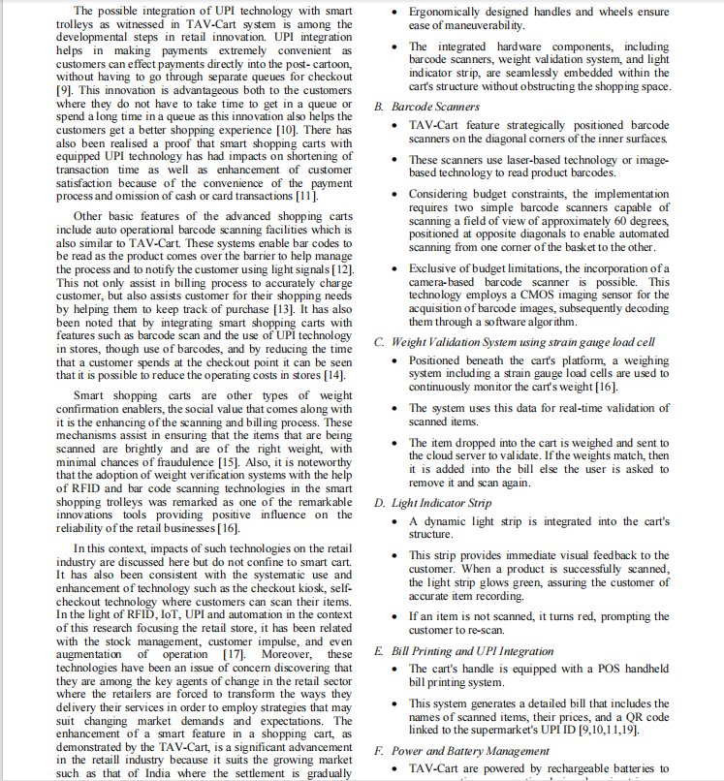
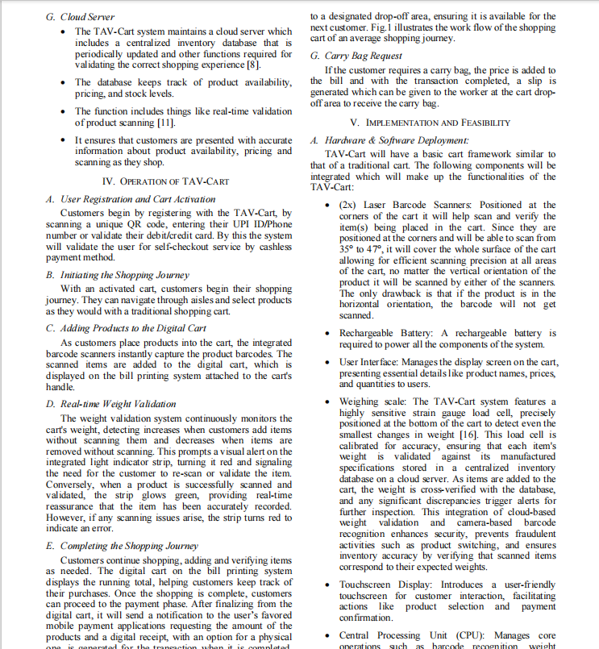
Research Paper

Slide 7
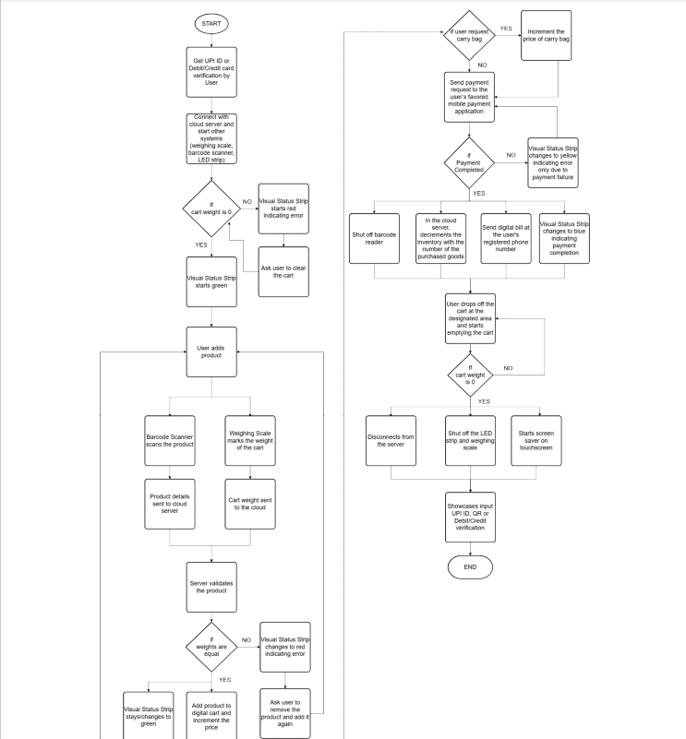
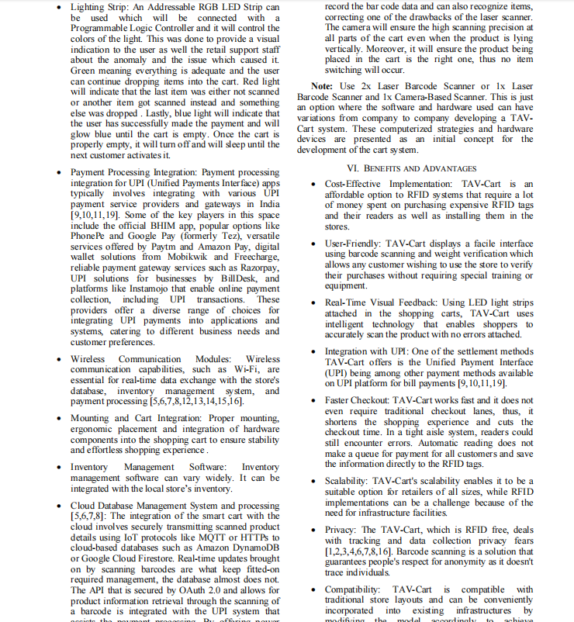
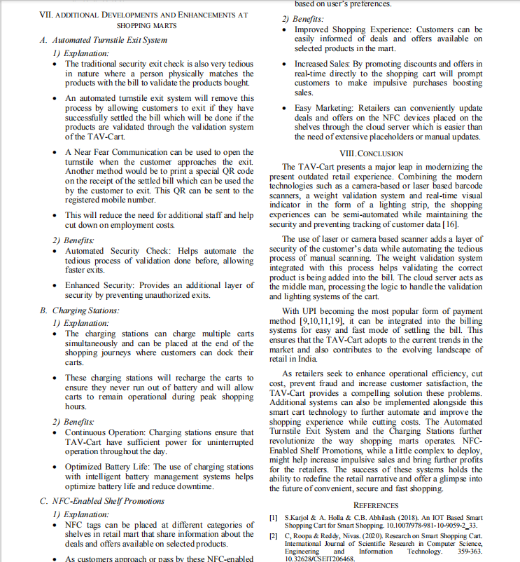
Research Paper

Slide 8
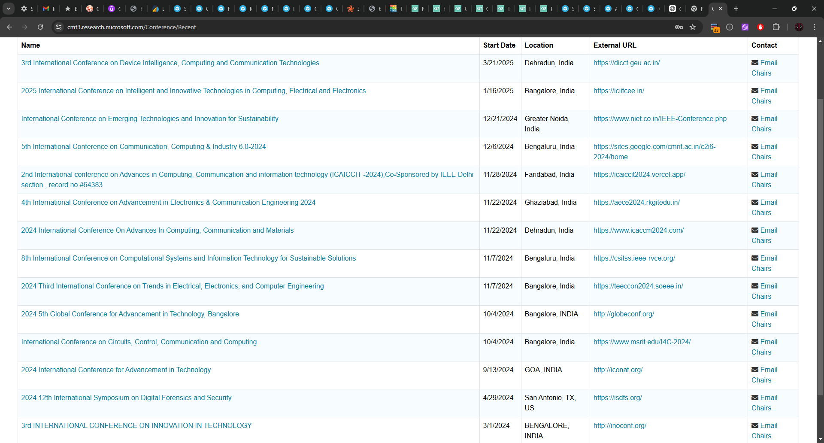
Conferences

Slide 9
Hardware Parts
Smartphone/Tablet/POS system - Preferably POS system but if cost is a issue then tablet
Barcode Scanner x2 capable of scanning for 1-2 meters
Weight Sensor
Load Cell Amplifier
Microcontroller - Already have Raspberry Pi but can use Arduino Uno or even mini to cut cost of the cart
Battery Pack - probably lithium ion
Wi-Fi Module
Cart/Bucket - Also plastic sheets/boards to enclose the wirings and other hardware
Programmable LED light
Speaker (optional)
NFC tags (optional)
Tools like screws, screwdriver, pilers, cutters, etc.

Slide 10
Thank you

